Slide 1
Biol 7200: Programming for Bioinformatics Week 6 assignment demos and broken code

Slide 2
Plan for today
Code demos
Broken code
If there’s time, cover points of confusion in lectures or handouts

Slide 3
Align.py

Slide 4
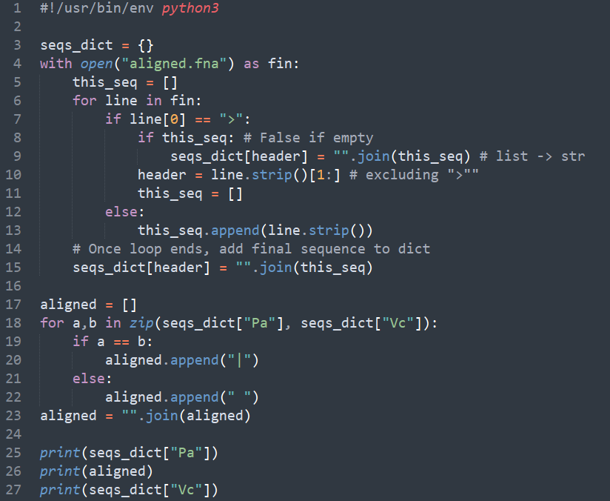
Notes:
#!/usr/bin/env python3
seqs_dict = {}
with open("aligned.fna") as fin:
this_seq = []
for line in fin:
if line[0] == ">":
if this_seq: # False if empty
seqs_dict[header] = "".join(this_seq) # list -> str
header = line.strip()[1:] # excluding ">""
this_seq = []
else:
this_seq.append(line.strip())
# Once loop ends, add final sequence to dict
seqs_dict[header] = "".join(this_seq)
aligned = []
for a,b in zip(seqs_dict["Pa"], seqs_dict["Vc"]):
if a == b:
aligned.append("|")
else:
aligned.append(" ")
aligned = "".join(aligned)
print(seqs_dict["Pa"])
print(aligned)
print(seqs_dict["Vc"])

Slide 5
Find_homologs.py (Extra Credit)

Slide 6
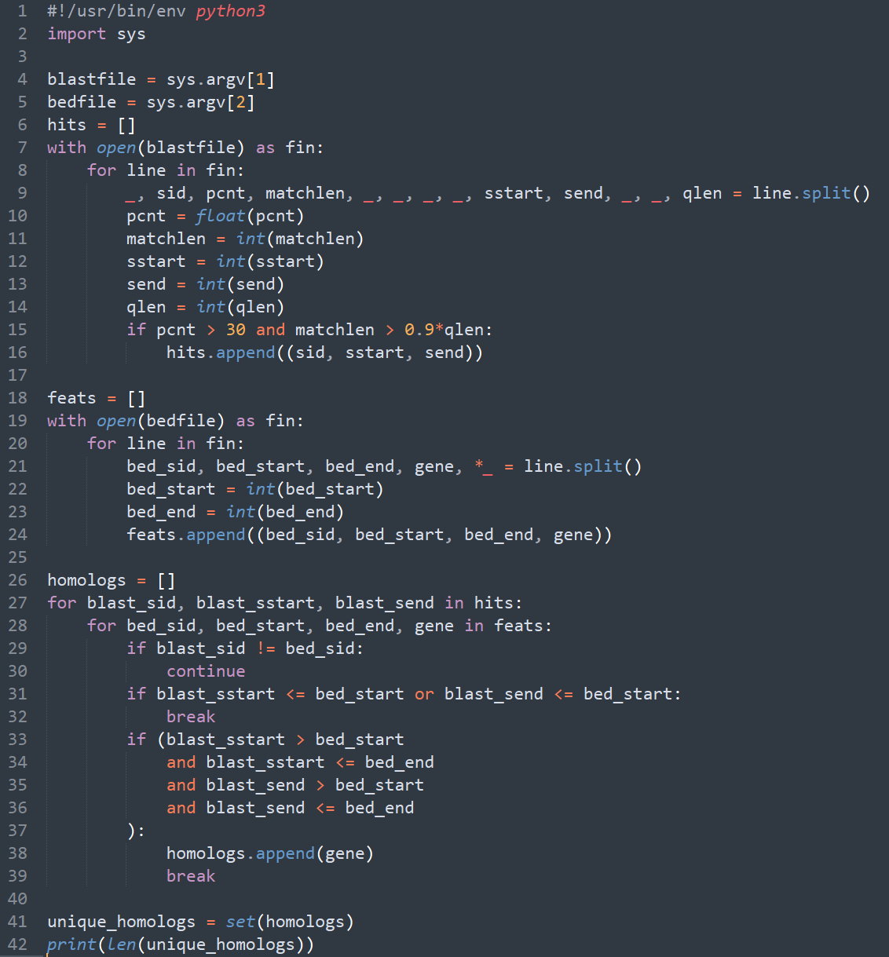
Notes:
#!/usr/bin/env python3
import sys
blastfile = sys.argv[1]
bedfile = sys.argv[2]
# read blast file
hits = []
with open(blastfile) as fin:
for line in fin: # .readlines() is the default iter method for the open file class
# unpack and convert types of desired columns. This is ugly. We'll revisit later...
_, sid, pcnt, matchlen, _, _, _, _, sstart, send, _, _, qlen = line.split()
pcnt = float(pcnt)
matchlen = int(matchlen)
sstart = int(sstart)
send = int(send)
qlen = int(qlen)
# Keep hits that could be homologs
if pcnt > 30 and matchlen > 0.9*qlen:
# We could store matches as a list or tuple.
# We won't want to modify the elements so a tuple is "safer"
# in that we then can't modify it by mistake
hits.append((sid, sstart, send))
# Now read the bed file
feats = []
with open(bedfile) as fin:
for line in fin:
# an asterisk before a variable name when unpacking
# makes that variable store remaining elements
bed_sid, bed_start, bed_end, gene, *_ = line.split()
bed_start = int(bed_start)
bed_end = int(bed_end)
feats.append((bed_sid, bed_start, bed_end, gene))
# Now we have our two datasets read in, we can loop over them to find matches
homologs = []
for blast_sid, blast_sstart, blast_send in hits: # unpack our blast data
for bed_sid, bed_start, bed_end, gene in feats:
# Don't bother checking the rest if the sid doens't match
if blast_sid != bed_sid:
continue
# Once we are dealing with features at higher index locations than our hit,
# go to the next hit (break loop over feats)
if blast_sstart <= bed_start or blast_send <= bed_start:
break
# Otherwise, check if the hit is inside the feature
if (blast_sstart > bed_start
and blast_sstart <= bed_end
and blast_send > bed_start
and blast_send <= bed_end
):
homologs.append(gene)
# Each BLAST hit will only be in one feature
# so move to next hit once you've found it
break
# Get the unique homologs using a set()
unique_homologs = set(homologs)
print(len(unique_homologs))

Slide 7
How many different ways can we loop over sequences?

Slide 8
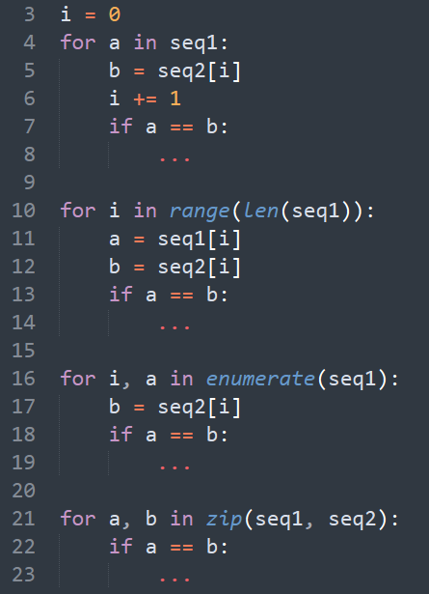

Slide 9
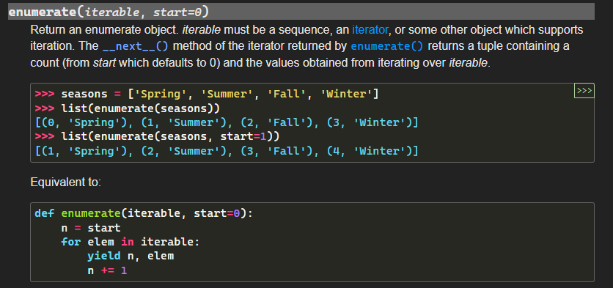
Side note, you could write an enumerate() now

Slide 10
End of demos
Next, broken code

Slide 11
Broken code structure reminder
What’s it trying to do?
What’s wrong with it?
How would you fix it?

Slide 12
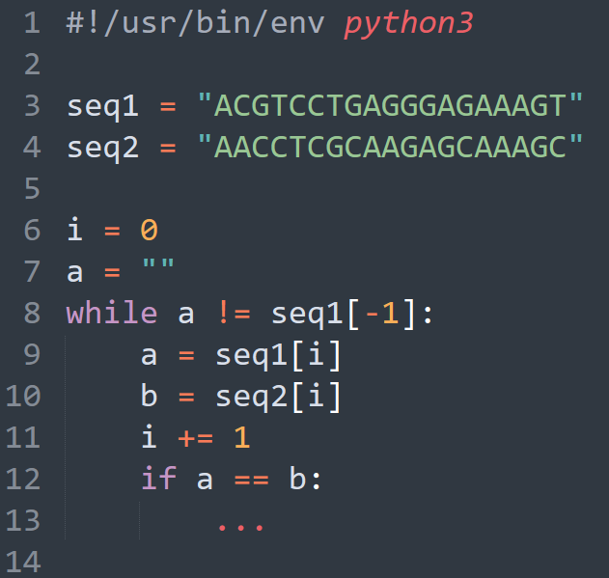
Broken code 1
What’s it trying to do?
What’s wrong with it?
How would you fix it?

Slide 13
Broken code 1
What’s it trying to do?
Compare aligned bases of two sequences
What’s wrong with it?
While loop condition checks equality with last base to check when we finish sequence
DNA has a 4-character alphabet so condition will be met quickly
How would you fix it?
Use while i < len(seq1) or code on earlier slide

Slide 14
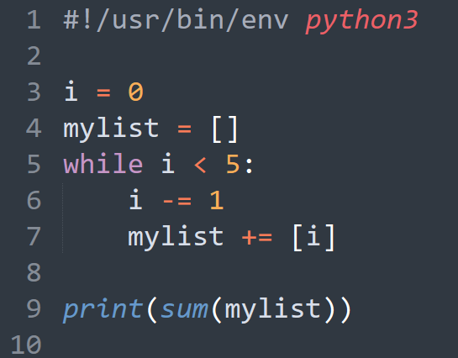
Broken code 2
What’s it trying to do?
What’s wrong with it?
How would you fix it?

Slide 15
Broken code 2
What’s it trying to do?
Use a while loop to build a list of a finite number of ints
What’s wrong with it?
While loop condition will never resolve as False as I -= 1
How would you fix it?
I += 1 or while I > -5

Slide 16
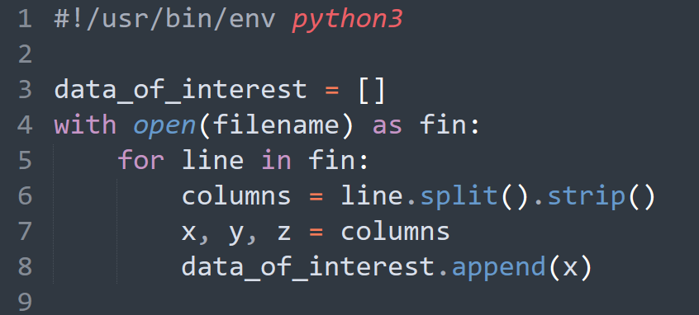
Broken code 3
What’s it trying to do?
What’s wrong with it?
How would you fix it?

Slide 17
Broken code 3
What’s it trying to do?
Extract a column of a file into a list
What’s wrong with it?
.strip() is a str method, but .split() returns a list
How would you fix it?
.strip() returns str so should come before .split()

Slide 18
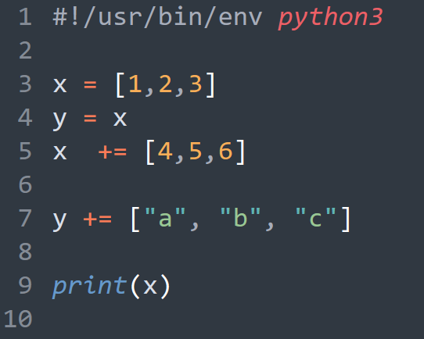
Broken code 4
What’s it trying to do?
What’s wrong with it?
How would you fix it?

Slide 19
Broken code 4
What’s it trying to do?
Copy a list and then modify each copy
What’s wrong with it?
x = y doesn’t create a copy of an object, it creates two pointers to the same object
Changes to either object are reflected in both x and y as they point to the same data
How would you fix it?
y = x.copy()
y = x[:]
from copy import deepcopy y = deepcopy(x)

Slide 20
End of Lesson

